Slide 1
Pointers
Chapter No 7
Notes:
Sir Syed University of Engineering and Technology.
Computer Programming and Problem Solving

Slide 2
Contents
Pointer Overview
Why are Pointers used?
Returning Data from Functions
Passing Value to a Function
Passing Addresses to a Function
Defining Pointer Variables
Pointers without Functions
Pointers and Arrays
Pointers and Strings

Slide 3
Overview
Pointers are regarded by most people as one of the most difficult topics in C Language.
Pointer provides a way of accessing a variable or a more complex kind of data, such as an array without referring to the variable directly.
Pointers are variables that contain memory addresses as their values.
The mechanism used for this is the address of the variable. In effect, the address acts as an intermediary between the variable and the program accessing it.

Slide 4
Why are Pointers used ?
Pointers are used in situations when passing actual values is difficult or undesirable.
  To return more than one value from a function.
  To pass arrays and strings more conveniently from one function to another.
  To manipulate arrays more easily by moving pointers to them, instead of moving the arrays themselves.

Slide 5
Why are Pointers used ?
  To create complex data structures, such as linked list and binary tress, where one data structures must contain references to other data structures.
  To communicate information about memory as in the function malloc( ), which returns the location of free memory by using a pointers.
  “ A pointer constant is an address; a pointer variable is a place to store addresses.”
Notes:
Sir Syed University of Engineering and Technology.
Computer Programming and Problem Solving

Slide 6
Pointers
Pointer is a variable that contains the address of a variable
  Here p is said to point to the variable c
C
…
7
3
4
…
172
173
174
175
176
177
178
179
180
181
P
…
174
3
4
…
832
833
834
835
836
837
838
839
840
841

Slide 7
Defining Pointer Variables
As with any variables, the places set aside for these addresses, px and py, must be defined, so the compiler will know how large a memory space to allot for them and what names we want to give them. Since we are storing addresses, or pointer constants, you might expect a whole new data type here, something along the lines of:
ptr px , py ; // not exactly how pointers are defined
where ptr might be the data type for pointers. After all, addresses are all the same size, and we want to set aside enough memory to hold an address.

Slide 8
Defining Pointer Variables
However, C Language is a concise language, so instead of using the word “ptr”, C Language uses the asterisk ( * ).
The asterisk * is used differently from the word representing simple data types i.e. int or float; the asterisk is used immediately before each variable, rather than being used once at the beginning of the definition. Thus, the real definition for two integer pointers is:
int *px , *py ; // correct definition of two pointers

Slide 9
Defining Pointer Variables
The definition set aside two bytes in which to store the address of an integer variable and gives this storage space the name px.
It also sets aside another two bytes in which to store the address of another integer variable and gives this space the name py.
The asterisks tell the compiler that these variables will contain addresses ( not values ), and the int tells it that the addresses will point to integer variables.

Slide 10
Format of pointer definition
The Format of pointer definition is shown below:
int *px , *py ;
Here
  px name of the pointer variable
  * indicates variable is a pointer i.e. it will hold an address.
  int indicates the pointer will point to variables of type integer

Slide 11
Referencing
The unary operator & gives the address of a variable
The statement
p = &c
assigns the address of c to the variable p, and now p points to c
To print a pointer, use %p format.

Slide 12
Referencing
int c;
int *p; /* Declare p as a pointer to int */
c = 7;
p = &c;
C
…
7
3
4
…
172
173
174
175
176
177
178
179
180
181
P
…
174
3
4
…
832
833
834
835
836
837
838
839
840
841

Slide 13
Dereferencing
The unary operator * is the Dereferencing operator
Applied on pointers
Access the object the pointer points to
The statement
*p = 5;
Puts in c (the variable pointed by p) the value 5

Slide 14
Dereferencing
printf (“%d”, *p ); /* Prints out ‘7’ */
*p = 177;
printf (“%d”, c ); /* Prints out ‘177’ */
p = 177; /* This is unadvisable! */
C
…
177
3
4
…
172
173
174
175
176
177
178
179
180
181
P
…
177
3
4
…
832
833
834
835
836
837
838
839
840
841

Slide 15
Use of & and *
When is & used?
When is * used?
& “Address Operator" which gives or produces the memory address of a data variable
* “Dereferencing Operator" which provides the contents in the memory location specified by a pointer

Slide 16
Returning Data from Functions
We are going to start our examination of pointers by finding out how functions can return multiple values to the program that called them.
You have already seen that it is possible to pass many values to a function and return a single value from it, but what happens when you want to return more than one value from a function to the calling program?

Slide 17
Passing Value to a Function
void gets2 ( int, int );
void main ( void )
{
int x = 5, y = 7 ;
gets2 ( x , y ) ;
getch ( ) ;
}
void gets2 ( int xx , int yy )
{
printf ( “ 1st no is %d, and 2nd no is %d”, xx , yy ) ;
}

Slide 18
Note
This is not an enormously useful function: it simply prints out the two values passed to it.
However, it demonstrates an important point: the function receives the two values from the calling program and stores them, or rather stores duplicates of them – in its own private memory space.
In fact, it can even give these values different names, known only to the function: in this case xx and yy instead of x and y.

Slide 19
Passing Addresses to a Function
void rets2 ( int * , int * ) ;
void main ( void )
{
int x , y ;
rets2 ( &x , &y ) ; // get values from function
printf ( “ 1st no is %d, and 2nd no is %d”, x , y ) ;
}
void rets2 ( int *px , int *py )
{
*px = 5 ; // set contents of px to 5
*py = 7 ;
}

Slide 20
Note
First, the calling program, instead of passing values to the function, passes it addresses.
These addresses are where the calling program wants the function to place the data it generates; in other words, they are the address of the variable in the calling program where we want to store the returned values.

Slide 21
Note
First, notice that the calling program itself never gives any values to the variable x and y.
The calling program told rets2 ( ) where to put the values by passing it addresses. It did this using the address operator &.
The expression rets2 ( &x , &y ); causes the addresses of x and y to be passed to the function and stored in the function’s private memory space. These addresses have been names by the function: px and py.

Slide 22
Going Both Ways
Once a function knows the addresses of the variables in the calling program, it not only can place values in these variables, it can also take values out. That is, pointers can be used not only to pass values from a function to the calling program, but also to pass them from the program to the function.

Slide 23
Program
void addcon ( int *px , int *py ) ;
void main ( void )
{
int x = 5 , y = 7 ;
addcon ( &x , &y ) ;
printf ( “ 1st No is %d, and 2nd No is %d”, x , y ) ;
}
void addcon ( int *px , int *py )
{
*px = *px + 10 ; // add 10 to the contents of px
*py = *py + 10 ;
}

Slide 24
Note
Here is the indirection operator has been on both sides of the equal sign. The first statement means that we get the contents of the variable pointed to by px ( this is x, whose value is 5 ), add 10 to it, an return the result to the same place ( the variable pointed to by px – which is still x but whose value will now be 15.
In other words, we can use the symbol *px, where px is a variable containing the address of x. almost exactly as we could have used the variable x itself, had it been accessible to us.

Slide 25
Pointers without Functions
void main ( void )
{
int x = 5 , y = 7 ;
int *px , *py ;
printf ( “ 1st No is %d, and 2nd No is %d”, x , y ) ;
px = &x ; // put addresses of numbers in pointers
py = &y ;
*px = *px + 10 ; // add 10 to the contents of px
*py = *py + 10 ;
printf ( “ 1st No is %d, and 2nd No is %d”, x , y ) ;
}

Slide 26
Note
Of course all this could have been handled much more easily with the statements:
x = x + 10 ; y = y + 10 ;
However, directly assigning values to the variables would not reveal nearly as much about pointers.
The new elements in the program are the assignment statements:
px = &x ; py = &y ;
These statements take the addresses of the variables x and y and put them in the pointer variables px and py.

Slide 27
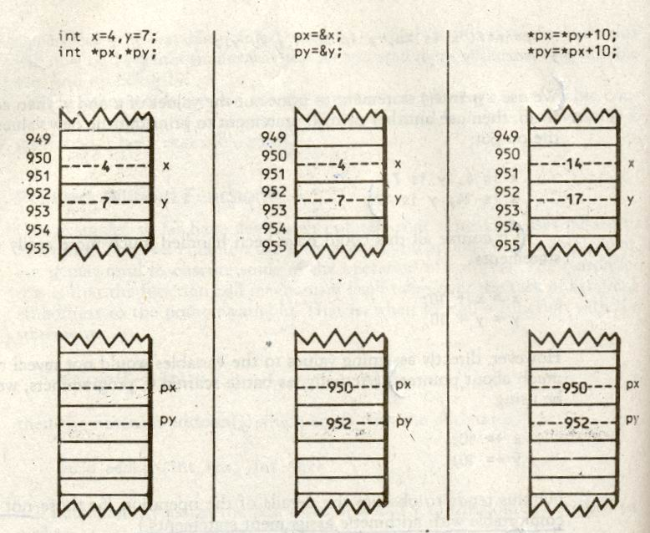
Operation of the Pointer Program

Slide 28
Summary
The moral is, make sure you assign a pointer variable an appropriate address before you use it. In short:
*ptr = contents of ptr
&var = address of var

Slide 29
Pointers with Functions (Example)
#include <stdio.h>
void swap ( int *a, int *b ) ;
int main ( )
{
int a = 5, b = 6;
printf (“ a = %d b = %d \n“ , a, b ) ;
swap (&a, &b) ;
printf( “ a = %d b = %d \n", a , b) ;
return 0 ;
}

Slide 30
Pointers with Functions (Example)
void swap ( int *a, int *b )
{
int temp;
temp = *a;
*a = *b;
*b = temp ;
printf ( "a = %d b=%d \n", *a, *b );
}
Output:
a = 5 b = 6
a = 6 b = 5
a = 6 b = 5

Slide 31
Swap Values
Example: Function to swap the values of two variables
Swap
x: 1
y: 2
x: 2
y: 1

Slide 32
Swap Values
void swap1(int , int );
void main(void)
{
int x = 1, y = 2;
swap1( x , y );
printf (“ %d %d \n”, x, y );
}
void swap1(int a, int b)
{
int tmp;
tmp = a;
a = b;
b = tmp;
}

Slide 33
Swap Values
void swap1(int *, int * );
void main(void)
{
int x = 1, y = 2;
swap1(&x , &y);
printf (“ %d %d \n”, x, y );
}
void swap1(int * a, int * b)
{
int tmp;
tmp = *a;
*a = *b;
*b = tmp;
}
tmp:
a:
addr of x
b:
addr of y
1
x:
y:
2

Slide 34
Keyword size of
The keyword sizeof ( ) can be used to determine the number of bytes in a data type, a variable, or an array
Example:
double array [10];
sizeof (double); /* Returns the value 8 */
sizeof (array); /* Returns the value 80 */
sizeof(array) / sizeof(double); /* Returns 10 */

Slide 35
Pointers and Arrays
An array notation for example table [x] [y], is really nothing more than a thinly disguised form of pointer notation.
In fact, the compiler translates array notation into pointers notation when compiling, since the internal architecture of the microprocessor understands pointers but does not understand arrays.

Slide 36
Program
void main ( void )
{
static int num [ ] = { 10, 20, 30, 40, 50 } ;
int index ;
for ( dex = 0 ; dex < 5 ; dex ++ )
printf ( “ %d \n “, num [ dex ] );
getch ( ) ;
}

Slide 37
Program
void main ( void )
{
static int num [ ] = { 10, 20, 30, 40, 50 } ;
int index ;
for ( dex = 0 ; dex < 5 ; dex ++ )
printf ( “ %d \n “, *(num + dex) );
getch ( ) ;
}

Slide 38
Note
This version is identical to the first, except for the expression *(num + dex ). What does it means?
Its effect is exactly the same as that of num [dex] in the earlier program; in other words, it accesses that elements of the array num whose subscript is contained in the variable dex.
Thus if, dex is 3, we will get element num [3], which is 40.

Slide 39
Note
However do we interrupt *(num + dex ) ? First as we know, num is the address of the array. Now if we add, say the number 3 to this address, what will we get?
In other words, if dex is 3, what is num+dex ? Would you guess the result would be an address three bytes from the start of the array? If so, you have not counted on the extreme cleverness of the designers of C language.

Slide 40
Note
Suppose, if the array num starts at 1400, then when dex is 3 we want num+dex to have the value 1406 – which is the address of num [3] , not the value 1403 which is the second half of num [1] and meaningless.
i.e num + 3 = 1400 + 3 + 2 = 1406

Slide 41
Note
In other words, if we say num+3, we do not mean three bytes, we mean three elements of the array: three integer if it is an integer array, three floating point numbers if it is floating point array and so on.
Now you should be able to figure out the meaning of the expression *(num + dex )
If dex is 3, then this expression means “ the contents of elements 3 of the array num [ ] “; this value is 40. Thus, as we noted, *(num + dex ) is the same thing as the num [ dex ]. They are both ways of referring to the contents of an array element.

Slide 42
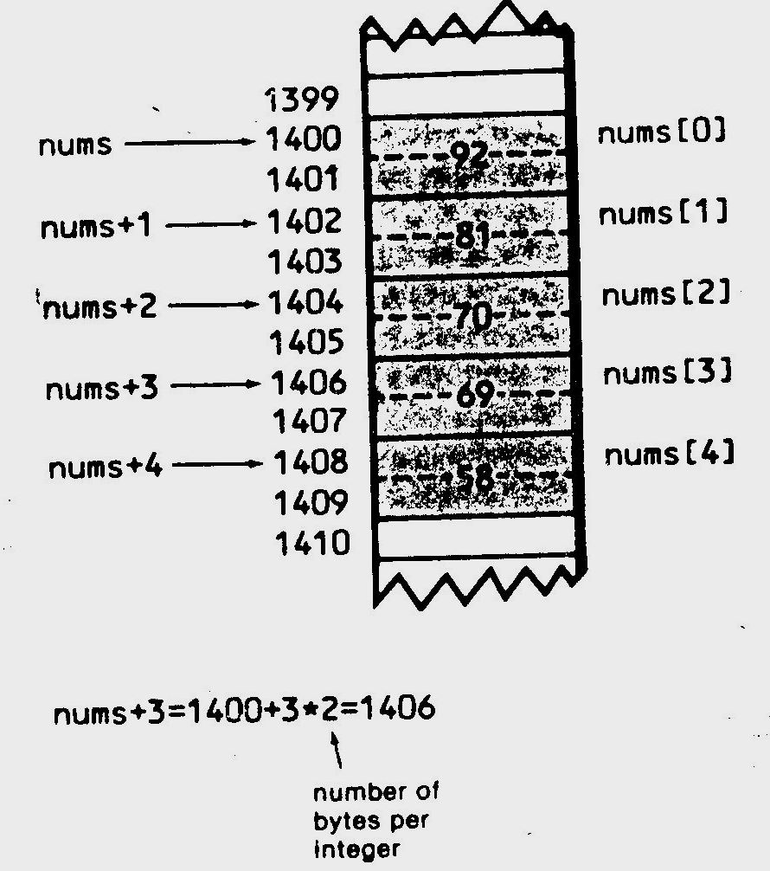
Pointer Addition

Slide 43
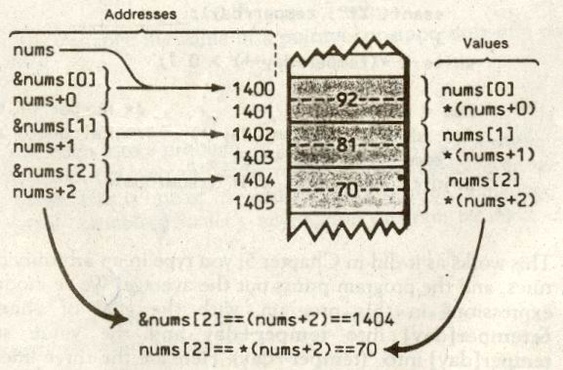
Addresses and Values

Slide 44
Summary
*( array + index ) is the same as array [ index ]
  &num[2] = = (num+2) = = Address
  num[2] = = *(num+2) = = Value
Note
“ You cannot change the value of a pointer constant, only of a pointer variable.”

Slide 45
Pointer Arithmetic
Pointers can be incremented and decremented
If p is a pointer to a particular type, p+1 yields the correct address of the next variable of the same type
p++, p+i, and p += i also make sense
If p and q point to elements in an array, q-p yields the number of elements between p and q.
However, there is a difference between pointer arithmetic and “regular” arithmetic.

Slide 46
Pointers to Arrays in Functions
# define SIZE 5
void addcon ( int * , int , int ) ;
void main ( void )
{
static int array [ SIZE ] = { 2, 3, 4, 5, 6 };
int loop, konst = 10 ;
addcon ( array, SIZE, konst ) ;
for ( loop = 0; loop < SIZE; loop ++ )
printf ( “ %d “, *(array+loop) ) ;
}

Slide 47
Program
void addcon ( int *ptr, int size, int con )
{
int a;
for ( a = 0; a < size; a ++ )
*(ptr+a) = *(ptr+a) + con ;
}

Slide 48
Note
Here the calling program supplies the address of the array, array; the size of the array, SIZE ( which is defined to be 5 ); and the constant to be added to each element, konst ( which is assigned the value 10 ).
The function assigns the address of the array to the pointer ptr, the size to the variable SIZE, and the constant to the variable con. Then a simple loop serves to add the constant to each elements of the array.

Slide 49
Pointers and Strings
void main ( void )
{
static char *salute = “Greetings“ ;
char name [81] ;
puts ( “ Enter your name : “ ) ;
gets ( name ) ;
puts ( salute ) ;
puts ( name ) ;
getch ( ) ;
}

Slide 50
Note
Here, to initialize the string, we have used the statement
static char *salute = “Greetings,“ ;
Instead of
static char salute [ ] = “Greetings,“ ;
The array notation version of this statement sets aside an array with enough bytes ( in this case 10 ) to hold word, plus one byte for the ‘ \0 ’ ( null character ). The address of the first character of the array is given the name of the array, in this case, salute. In the pointer version, an array is set aside in the same way, but a pointer variable is also set aside; it is this pointer that is given the name salute.

Slide 51
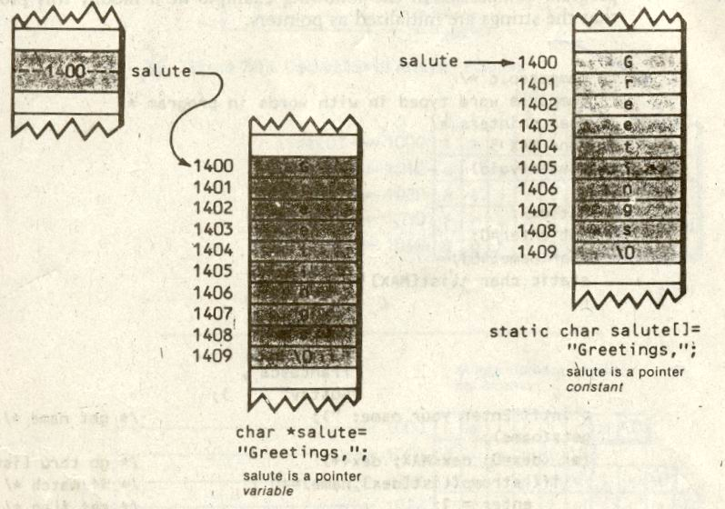
Strings Arrays versus String Pointer

Slide 52
Note
In the array style of initialization, salute is a pointer constant, an address which cannot be changed. In the pointer style, salute, is a pointer variable, which can be changed.
For instance, the expression: puts ( ++ salute ) ;
would prints the string starting with the second character in the string: reetings
The added flexibility of the pointer approach can often be used to advantage.

Slide 53
Initializing an Array of Pointers to Strings
# define MAX 5
void main ( void )
{
int dex , enter = 0 ;
char name [ 40 ] ;
static char *list [ MAX ] = { “ali” ,
“basit”
“kamran”
“majid”
“ahmad” } ;

Slide 54
Initializing an Array of Pointers to Strings
printf ( “ Enter your name: “ );
gets ( name ) ;
for ( dex = 0 ; dex < MAX ; dex ++ )
if ( strcmp ( list [dex] , name ) == 0 )
enter = 1 ;
if ( enter = = 1 )
printf ( “ You may enter, valid person “ ) ;
else
printf ( “ Guard! Remove this person! “ ) ;
getch ( ) ;
}

Slide 55
Note
What does the expression char *list [ MAX ] means? Such complex expression are generally deciphered from right to left so, this one means an array of pointers to characters.
In the array version of this program, the strings were stored in a rectangular array with 5 rows and 10 columns. In the new version, the strings are stored contiguously in memory; they do not form an array, so there is no wasted space between them. However, an array of pointers to these strings has been created.

Slide 56
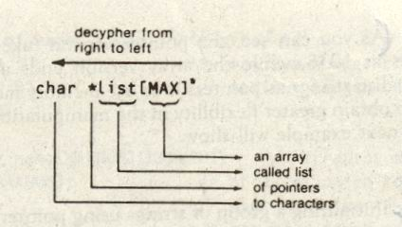
Declaration of Array of Pointer

Slide 57
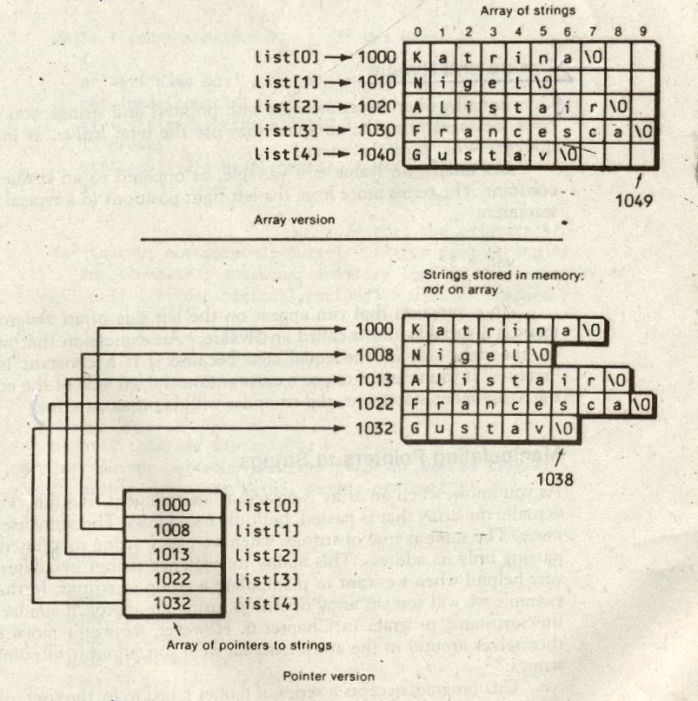
Arrays of Strings Versus Arrays of Pointers

Slide 58
Note
As you can see, the pointer version takes up less space in memory; it ends at 1038, while the array version ends at 1049. Thus, one reason to initialize as pointers is to use memory more efficiently. Another reason is to obtain greater flexibility in the manipulation of the strings in the array.
“ Initializing a group of strings using pointer notation uses less memory than initializing them as a two-dimensional array. “

Slide 59
Lvalue & Rvalue
Occasionally, when experimenting with pointers and strings, you may receive error messages that use the term Lvalue, as in “ Lvalue required “. What does this means?
Essentially, an Lvalue is a variable, as opposed to an Rvalue, which is a constant.
The term arose from the left-right positions in a typical assignment statement: var = 3 ;
An expression that can appear on the left side of an assignment statement is a variable and is called an Lvalue. An expression that must remain on the right side of the equal sign because it is a constant is called the Rvalue.
If you attempt to use a constant on the left side of the equal sign in the assignment statement, the compiler will flag it as an error.

Slide 60
Manipulating Pointers to Strings
# define MAXNUM 30
# define MAXLEN 81
void main ( void )
{
static char name [ MAXNUM ] [ MAXLEN ] ;
char *temp , *ptr [ MAXNUM ] ;
int in, out , count = 0 ;

Slide 61
Manipulating Pointers to Strings
while ( count < MAXNUM )
{
printf ( “ Name %d “, count + 1 ) ;
gets ( name [ count ] ) ;
if ( strlen ( name [ count ] = = 0 )
break ;
ptr [ count++ ] = name [ count ] ;
}

Slide 62
Manipulating Pointers to Strings
for ( out = 0 ; out < count –1 ; out ++ )
for ( in = out + 1 ; in < count ; in ++ )
if ( strcmp ( ptr [ out ] , ptr [ in ] > 0 )
{
temp = ptr [ in ] ;
ptr [ in ] = ptr [ out ] ;
ptr [ out ] = temp ;
}
printf ( “ \n Sorted List: \n “ ) ;
for ( out = 0 ; out < count –1 ; out ++ )
printf ( “ Name %d : %s \n “, out + 1, ptr [ out ] ) ;
}

Slide 63
Manipulating Pointers to Strings
Output
Name 1: Majid
Name 2: Basit
Name 3: Ali
Name 4: Kamran
Name 5: Zia
Sorted List
Name 1: Ali
Name 2: Basit
Name 3: Kamran
Name 4: Majid
Name 5: Zia

Slide 64
Note
This program uses both an array of strings and an array of pointers. The pointers occupy the array declared by the expression:
char *ptr [ MAXNUM ]
The string occupy a two-dimensional array:
static char name [ MAXNUM ] [ MAXLEN ] ;
Because we do not know in advance how long they will be, we must use a rectangular array to hold the strings that are typed in.

Slide 65
Note
As the string are read in, the statement: ptr [ count++ ] = name [ count ] ;
Assigns the address of each string, which is stored in the array name [ ] [ ], to an element of the pointer array ptr [ ]. Then this array of pointers is sorted.
Finally, the strings are printed out in the alphabetical order, using the array of pointers as a reference. The array name [ ] [ ] itself remains unchanged; only the pointers to the elements of the array have been rearranged.

Slide 66
Double Indirection: Pointers to Pointers
# define ROWS 4
# define COLS 5
void main ( void )
{ int j, k;
static int table [ ROWS ] [ COLS ] = { { 1,2,3,4,5 } ,
{ 6,7,8,9,0 } ,
{ 1,3,5,7,9 } ,
{ 2,4,6,8,0 } } ;
for ( j = 0 ; j < ROWS ; j ++ )
for ( k = 0 ; k < COLS ; k ++ )
table [ j ] [ k ] = table [ j ] [ k ] + 10 ;
printf ( “ \n “ ) ;

Slide 67
Double Indirection: Pointers to Pointers
for ( j = 0 ; j < ROWS ; j ++ )
{
for ( k = 0 ; k < COLS ; k ++ )
printf ( “ %d “, table [ j ] [ k] ) ;
printf ( “ \n “ ) ;
}
}
Output
11 12 13 14 15
16 17 18 19 10
11 13 15 17 19
12 14 16 18 10

Slide 68
Double Indirection: Pointers to Pointers
“An element of a two-dimensional array can be referred with a pointer to a pointer.”
In other words,
table [ j ] [ k ] = * ( * ( table + j ) + k )

Slide 69
Double Indirection: Pointers to Pointers
# define ROWS 4
# define COLS 5
void main ( void )
{ int j, k;
static int table [ ROWS ] [ COLS ] = { { 1,2,3,4,5 } ,
{ 6,7,8,9,0 } ,
{ 1,3,5,7,9 } ,
{ 2,4,6,8,0 } } ;
for ( j = 0 ; j < ROWS ; j ++ )
for ( k = 0 ; k < COLS ; k ++ )
( * table + j ) + k ) = * ( * ( table + j ) + k ) + 10 ; printf ( “ \n “ ) ;

Slide 70
Double Indirection: Pointers to Pointers
for ( j = 0 ; j < ROWS ; j ++ )
{
for ( k = 0 ; k < COLS ; k ++ )
printf ( “ %d “, table [ j ] [ k] ) ;
printf ( “ \n “ ) ;
}
}
Output
11 12 13 14 15
16 17 18 19 10
11 13 15 17 19
12 14 16 18 10

Slide 71
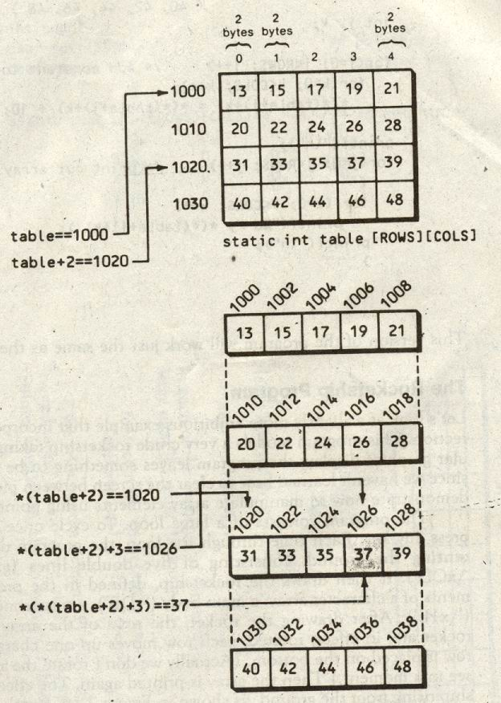
Note

Slide 72
Generic Pointers
Pointers are all the same size underneath
  All pointers are same size regardless of what they point to (because memory addresses are all within the same range of values)
Sometimes convenient to treat all pointer types interchangeably
Generic pointer type: void *
Function that expects void * can take any pointer as argument
Important in malloc/free

Slide 73
Dynamic Memory Allocation
Declaring variables of fixed size allocates memory in a static way – variables do not change as program runs
Can also declare memory dynamically
  Allocate different amounts of memory from run to run of the program
  Increase/reduce amount of memory as program runs
More flexible technique: combine pointers with the function malloc()
malloc ( ) and free ( ) are in stdlib.h

Slide 74
Using malloc ( )
char * str = NULL; // allocate 10 bytes to be used
// to store char values
str = (char *) malloc(10);
// when finished, clean up free(str);

Slide 75
Malloc
malloc ( ) takes the number of bytes to allocate
returns void * pointer
Problems:
  need to calculate the number of bytes
  need to use the void * pointer as pointer of type you want to use (eg, int *, char *)

Slide 76
Calculating Bytes
Sizeof ( <type> ) – returns the number of bytes used by a single variable of that type
multiply this value by however many variables of this type you want to store
int intArray [10];
int * iarray = (int *) malloc (sizeof (int) * 10 );

Slide 77
Program-1
void main ( void )
{
int *p q ;
q = 100; // assign q = 100
p = &q; // assign p the address of q
printf ( “ %d “ , p ) ; // print q’s value using pointer
getch ( ) ;
}
Output 100

Slide 78
Program-2
void main ( void )
{
int *p q ;
p = &q; // assign p the address of q
*p = 199; // assign q a value using pointer
printf ( “ %d “ , q ) ; // print q’s value
getch ( ) ;
}
Output 199

Slide 79
Program-3
void main ( void )
{
int *p q ;
*p = 55;
printf ( “ Value of p is %d “ , p ) ;
}
Output WRONG
p is not pointing to anything

Slide 80
Program-4
void main ( void )
{
int *p, q;
p = &q;
q = 1;
printf (“ %p \n“ , p );
*p++; // No increment in q
printf ( “ %d %p ", q , p );
}
Output FFF4
1 FFF6

Slide 81
Program-5
void main ( void )
{
int *p, q;
p = &q;
q = 1;
printf (“ %p \n“ , p );
(*p)++; // Incremented q , p unchanged
printf ( “ %d %p ", q , p );
}
Output FFF4
2 FFF4

Slide 82
Program-6
void main ( void )
{
char **mp , *p, ch;
p = &ch;
mp = &p;
**mp = 'A';
printf (“ Value is %c \n“ , *p );
printf (“ Value is %c \n“ , **mp );
}
Output Value is A
Value is A

Slide 83
Program-7
int i = 2 , j = 3; /* integers variables */
int list [4] = {1,6,4,8};
int *pNow, *p1, *p2; /* integer pointers */
p1 = &i; /* p1 refers to i */
pNow = list + 1; /* pNow[0] == list[1] */
p2 = 1 + & ( list[2] ); /* p2 refers to list[3]*/
printf (“ %d, %d, %d\n”,pNow[0], p1[0], p2[0]);
Output 6 , 2 , 8

Slide 84
Program-8
void main ( void )
{
int i = - 5, j = - 2 ;
abc ( i , &j ) ;
printf ( “ \n i = %d j = %d “, i , j ) ;
}
abc ( int i, int * j )
{
i = i * i ;
*j = *j * *j ;
}

Slide 85
Program-9
void main ( void )
{ int i , j ;
int stud [5] [2] = { { 1 , 2 } ,
{ 3 , 4 } ,
{ 5 , 6 } ,
{ 7 , 8 } ,
{ 9 , 0 } } ;
for ( i = 0 ; i <= 4; i ++ )
{ printf ( “ \n ) ;
for ( j = 0 ; j < = 1; j++ )
printf ( “ %d “, * ( * ( stud + i ) + j ) ) ;
}
}

Slide 86
Program-9
Output
1 2
3 4
5 6
7 8
9 0

Slide 87
Program-10
void main ( void )
{
int a [2] [3] [2] = { { { 2 , 4 } ,
{ 7 , 8 } ,
{ 3 , 4 } ,
} ,
{ { 2 , 2 } ,
{ 2 , 3 }
{ 3 , 4 }
} } ;

Slide 88
Program-10
printf ( “ \n %u “, a ) ;
printf ( “ \n %u “, *a ) ;
printf ( “ \n %u “, **a ) ;
printf ( “ \n %d “, ***a ) ;
printf ( “ \n %u “, a+1 ) ;
printf ( “ \n %u “, *a+1 ) ;
printf ( “ \n %u “, **a+1 ) ;
printf ( “ \n %d “, ***a+1 ) ;
getch( ) ;
}

Slide 89
Program-10
Output
  104
  104
  104
  2
  116
  108
  106
  3
1th 2-D Array
1th 2-D Array
2
4
7
8
3
4
2
2
2
3
3
4
104 106 108 110 112 114 116 118 120 122 124 126

Slide 90
Program-11
void main ( void )
{
static int a[ ] = { 0, 1, 2, 3, 4 } ;
static int *p[ ] = { a, a+1, a+2, a+3, a+4 } ;
printf ( “ \n %u %u %d “, p, *p, *(*p) ) ;
getch ( ) ;
}
Output
    180 170 0

Slide 91
Program-12
void main ( void )
{
int n [25] ;
n [0] = 100 ;
n [24] = 200 ;
printf ( “ \n %d %d “, *n, *(n+24) + *(n+0) ) ;
getch ( ) ;
}
Output
      100 300

Slide 92
Program-13
void main ( void )
{
int b [ ] = { 10, 20, 30, 40 50 } ;
int i, *k ;
k = &b[4] – 4 ;
for ( i = 0; i <= 4; i++ )
{
printf ( “ %d “, *k ) ;
k++ ;
}
}
Output 10 20 30 40 50

Slide 93
Program-14
void main ( void )
{
int i , a [ ] = { 2, 4, 6, 8, 10 } ;
for ( i = 0; i <= 4; i++ )
{
*( a+i ) = a[i] + i[a] ;
printf ( “ %d “, *(i+a) ) ;
}
}
Output 4 8 12 16 20

Slide 94
Program-15
void main ( void )
{
int a [ 5 ] = { 2, 4, 6, 8, 10 } ;
int i, b = 5 ;
for ( i = 0; i < 5; i++ )
{
f ( a[i], &b ) ;
printf ( “\n %d %d “, a[i], b ) ;
}
}

Slide 95
Program-16
void f ( int x, int *y )
{
x = *(y) += 2 ‘
}
Output
2 7
  4 9
  6 11
  8 13
  10 15

Slide 96
Program-17
void main ( void )
{
int arr [ ] = { 0, 1, 2, 3, 4 } ;
int i, *p ;
for ( p = arr, i = 0; p+i <= arr+4 ; p++, i++ )
printf ( “\n %d “, *(p+i) ) ;
}
Output 0 2 4

Slide 97
Program-18
void main ( void )
{
char s [ ] = “ C Language! “;
printf ( “ \n %c ”, *(&s[4] ) ) ;
printf ( “ \n %s ”, s+5 ) ;
printf ( “ \n %s ”, s ) ;
printf ( “ \n %c ”, *(s+2) ) ;
printf ( “ \n %u ”, s ) ;
}

Slide 98
Program-18
Output
  a
  nguage!
  C Language!
  65510

Slide 99
Saying Regarding POINTERS…
“Pointers can be made to work, if you fiddle with them long enough. If you fiddle with anything long enough you will ultimately mess it.”
“No matter how much time you have spent with pointers you will always find some application of it, which would leave you guessing.”

